Slide 1

The F# Community – What it is and How it works
@dsyme, researcher at microsoft, f# community contributor

Slide 2
First, a little about F#

Slide 3
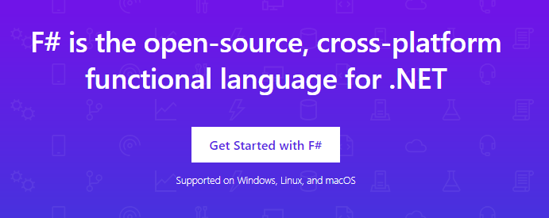
www.microsoft.com/net/

Slide 4
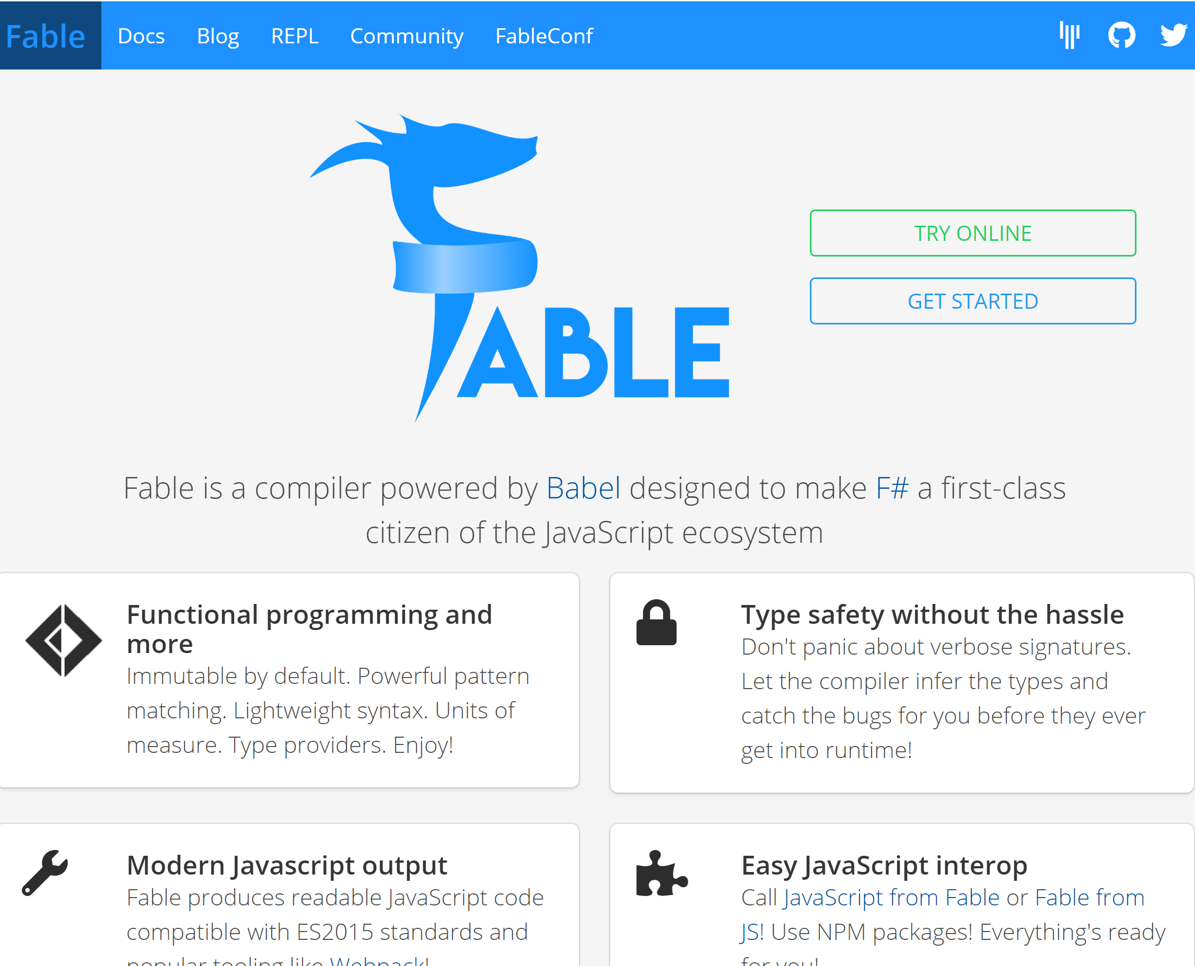

Slide 5
A functional-first approach makes a huge difference in practice fsharp.org/testimonials

Slide 6
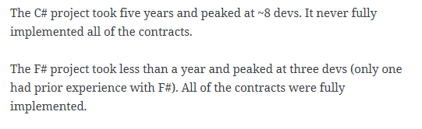
An analysis (Simon Cousins, Energy Sector)
350,000
lines of C# OO
by offshore team
30,000
lines of robust F#, with
parallel +more features
An application to evaluate the revenue due from Balancing Services contracts in the UK energy industry
http://simontcousins.azurewebsites.net/does-the-language-you-use-make-a-difference-revisited/

Slide 7
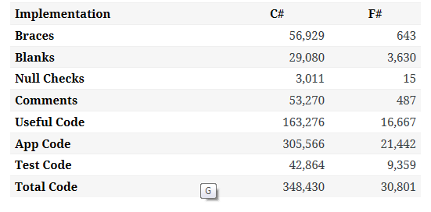

Slide 8
TL;DR – Where we are now
F# is open, cross-platform, neutral, independent
The F# Compiler Service powers other tools
F# 4.7 now complete!
.NET Core for Linux/OSX
All F# language and tooling is accepting contributions
Fable for F#-to-Javascript
SAFE for F# fullstack
The F# community is self-empowered
fsharp.org
VSCode, VS for Windows, Mac
Xamarin tools for Android, iOS, macOS etc.

Slide 9
F# and .NET Core (Linux, OSX, Windows) dotnet new -lang F# dotnet build docs.microsoft.com/dotnet/core/

Slide 10
But how did we get here? How did the F# community get created and how does it work?

Slide 11
The Early History of F# - HOPL IV (2020) fsharp.org/history

Slide 12
Technique #1 The Community at the Centre of the Technology The F# Pivot of 2013 - From Proprietary to Open

Slide 13

Old think…

Slide 14



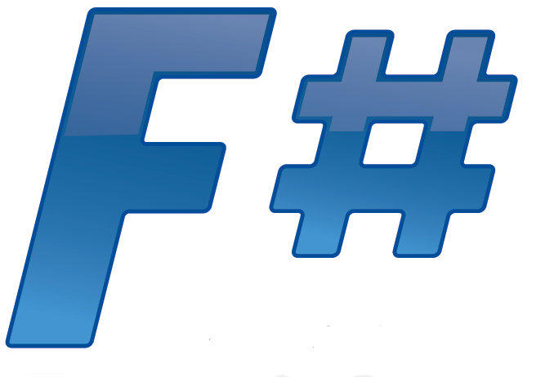





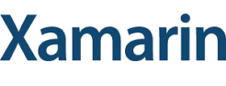



New think…
Visual Studio, .
.NET, SDKs, Tools
…
Visual F# Tools
F# Language
F# Open Source
Group
tryfsharp.org
F# Software
Foundation
F# Community
Groups
fpish.net
tryfs.org
fssnip.net
tryfs.org
fsharpforfunandprofit.com
Xamarin Studio

Slide 15
Technique #2 The Community at the Centre of Design & Implementation Suggestions: github.com/fsharp/fslang-design Designs github.com/fsharp/fslang-suggestions Implementation github.com/dotnet/fsharp

Slide 16
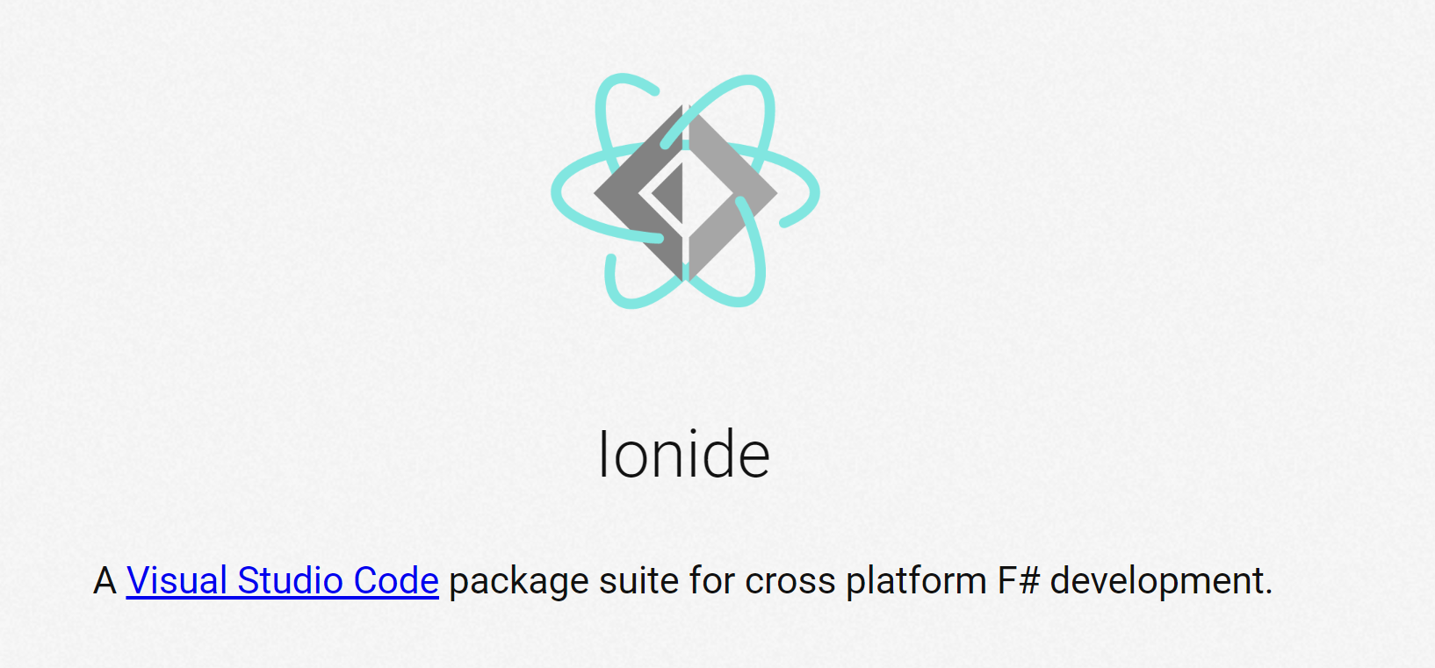
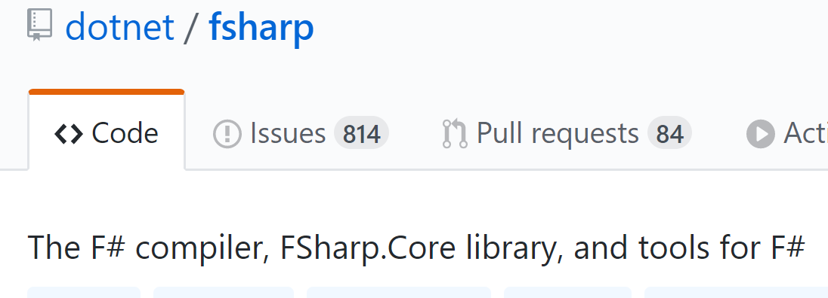
Technique #3 The Community at the Centre of Tooling

Slide 17
Technique #4 A Foundation at the Centre of the Community… …that embodies the ethics and spirit of the community and represents its interests positively http://foundation.fsharp.org

Slide 18
Technique #5 The Community at the Centre of Incubation http://fsprojects.github.io and much more Balancing trust, consistency and innovation

Slide 19
Technique #6 The Community owns the Message The core message about F# is decided by the community Microsoft is part of the community, so are many other interests F# Conferences are F# Events run by the F# Community

Slide 20
Technique #7 Balance the Forces in the Community Communities are a balance of interests and forces There need to be truly neutral zones Commercial interests are important but must not dominate Take the long term into account

Slide 21
Technique #7 Balance the Forces in the Community Communities are a balance of interests and forces There need to be truly neutral zones Commercial interests are important but must not dominate Take the long term into account

Slide 22
Please, get involved in the core technologies programming languages runtimes frameworks Invent, Create, Initiate, Lead, Contribute, Collaborate, Govern, Sustain

Slide 23
Questions?

Slide 24
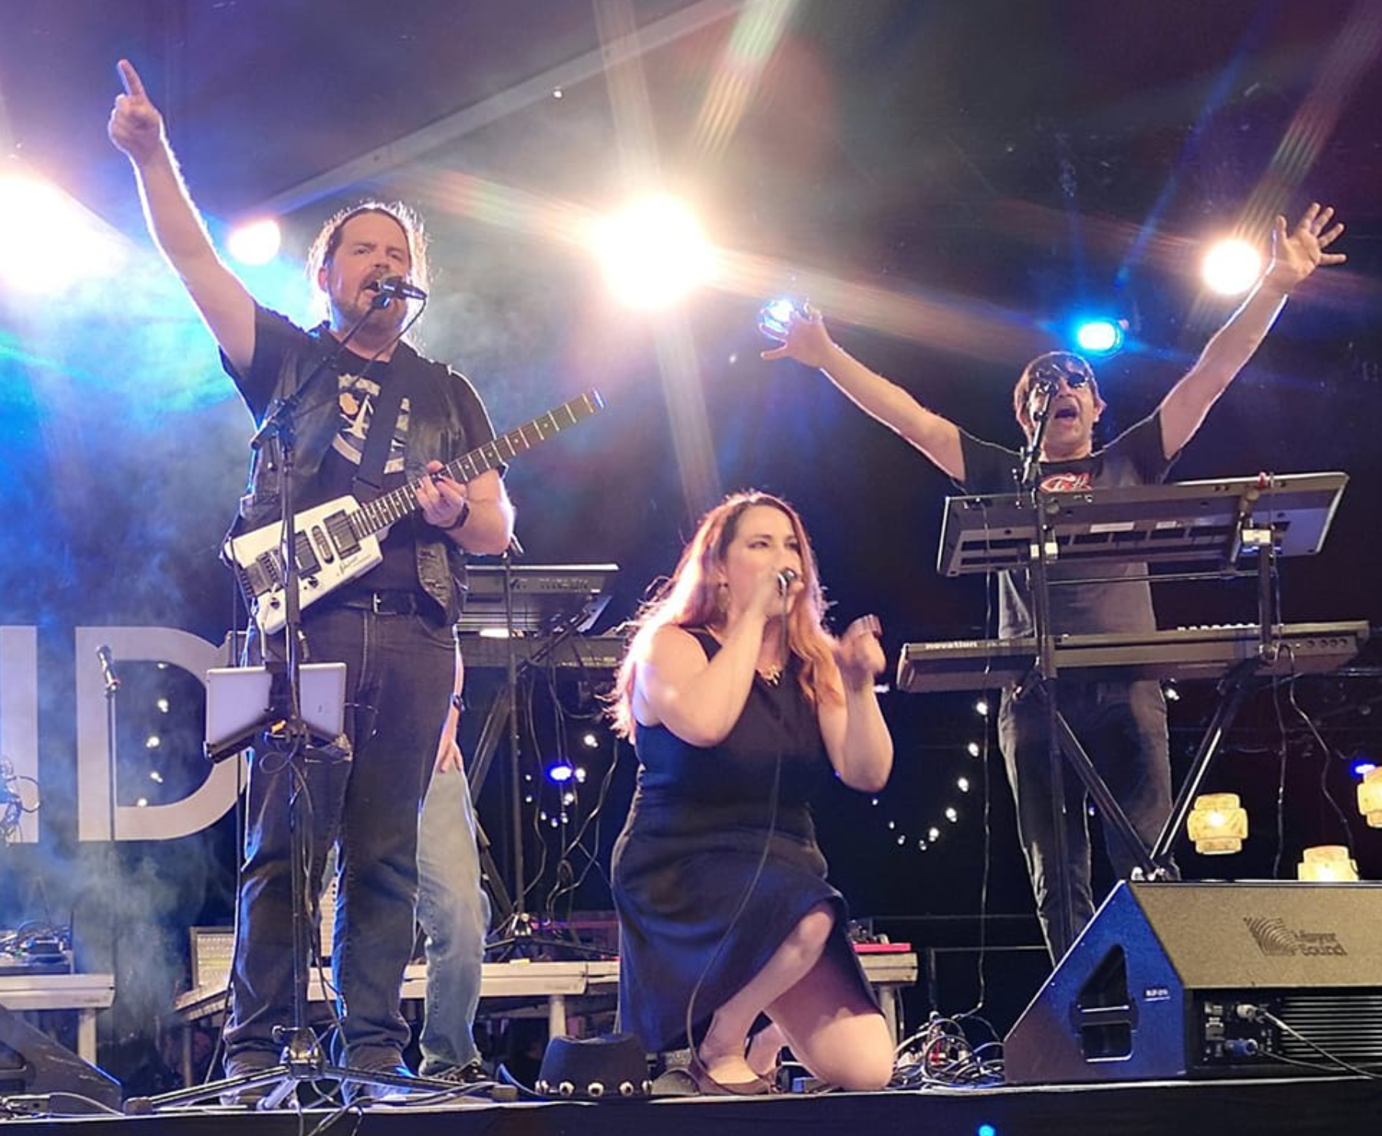

Slide 25
F# 4.0 ✔ True shift to cross-platform open engineering ✔ Long laundry list of language items ✔ Normalized core library ✔ Type providers more powerful ✔ Better debugging, tooling, performance ✔ ~20% compiler perf improvement
https://github.com/fsharp/fslang-design/tree/master/FSharp-4.0

Slide 26
F# 4.1 ✔ Optional large scope cycles more on this later) ✔ Result<T,Error> in standard library ✔ Unboxed (struct) tuples ✔ Unboxed (struct) records ✔ Unboxed (struct) unions ✔ More bits and pieces
https://github.com/fsharp/fslang-design/tree/master/FSharp-4.1

Slide 27
F# 4.5 ✔ Span<T> high perf type-safe non-allocating code ✔ Improved async debugging ✔ More bits and pieces
https://github.com/fsharp/fslang-design/tree/master/FSharp-4.5

Slide 28
F# 4.6 ✔ Anonymous records ✔ More bits and pieces
https://github.com/fsharp/fslang-design/tree/master/FSharp-4.5

